Slide 1

LAB 1 – WIRESHARK INTRODUCTION
Computer Networking

Slide 2
packet snifferS
The basic tool for observing the messages exchanged between executing protocol entities
Captures (“sniffs”) messages being sent/received from/by your computer
Store and/or display the contents of the various protocol fields in these captured messages

Slide 3
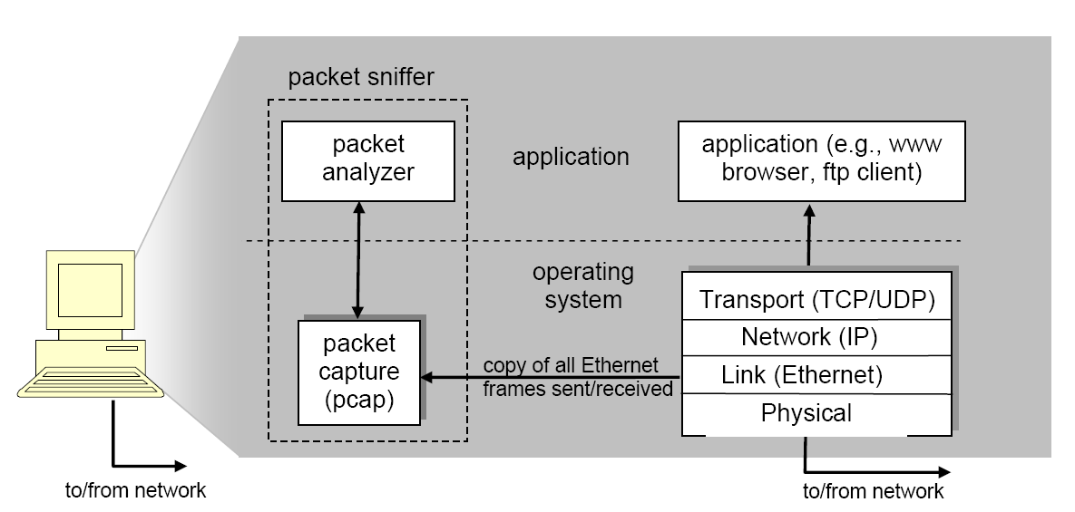
Packet sniffer structure

Slide 4
Packet sniffer structure
The packet capture library receives a copy of every link-layer frame that is sent from or received by your computer.
The packet analyzer displays the contents of all fields within a protocol message.

Slide 5
Getting Wireshark
Download and install the Wireshark software: http://www.wireshark.org/download.html
Windows PortableApps (32-bit)

Slide 6
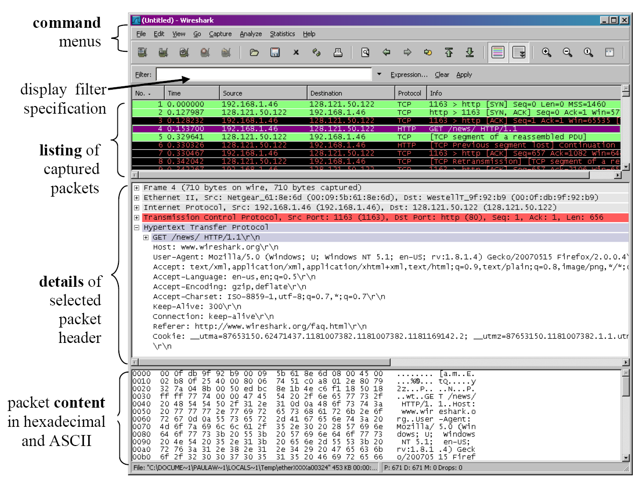
Running Wireshark
Notes:
The Wireshark interface has five major components:
• The command menus are standard pulldown menus located at the top of the
window. Of interest to us now are the File and Capture menus. The File menu
allows you to save captured packet data or open a file containing previously
captured packet data, and exit the Wireshark application. The Capture menu
allows you to begin packet capture.
• The packet-listing window displays a one-line summary for each packet
captured, including the packet number (assigned by Wireshark; this is not a
packet number contained in any protocol’s header), the time at which the packet
was captured, the packet’s source and destination addresses, the protocol type,
and protocol-specific information contained in the packet. The packet listing can
be sorted according to any of these categories by clicking on a column name. The
protocol type field lists the highest level protocol that sent or received this packet,
i.e., the protocol that is the source or ultimate sink for this packet.
• The packet-header details window provides details about the packet selected
(highlighted) in the packet listing window. (To select a packet in the packet
listing window, place the cursor over the packet’s one-line summary in the packet
listing window and click with the left mouse button.). These details include
information about the Ethernet frame (assuming the packet was sent/receiverd
over an Ethernet interface) and IP datagram that contains this packet. The amount
of Ethernet and IP-layer detail displayed can be expanded or minimized by
clicking on the plus minus boxes to the left of the Ethernet frame or IP datagram
line in the packet details window. If the packet has been carried over TCP or
UDP, TCP or UDP details will also be displayed, which can similarly be
expanded or minimized. Finally, details about the highest level protocol that sent
or received this packet are also provided.
• The packet-contents window displays the entire contents of the captured frame,
in both ASCII and hexadecimal format.
• Towards the top of the Wireshark graphical user interface, is the packet display
filter field, into which a protocol name or other information can be entered in
order to filter the information displayed in the packet-listing window (and hence
the packet-header and packet-contents windows). In the example below, we’ll
use the packet-display filter field to have Wireshark hide (not display) packets
except those that correspond to HTTP messages.

Slide 7
Taking Wireshark for a Test Run
Start up your favorite web browser
Start up the Wireshark software
To begin packet capture, select the Capture pull down menu and select Options
Select an interface that is being used to send and receive packets, click Start
Once you begin packet capture, a packet capture summary window will appear

Slide 8
Taking Wireshark for a Test Run
Enter the URL: http://gaia.cs.umass.edu/wireshark-labs/INTRO-wireshark-file1.html
Stop Wireshark packet capture by selecting stop in the Wireshark capture window.
Type in “http” into the display filter specification window, then select Apply
Select the first http message shown in the packet-listing window

Slide 9
QUESTIONS
List the different protocols that appear in the protocol column in the unfiltered packet-listing window in step 7 above.
How long did it take from when the HTTP GET message was sent until the HTTP OK reply was received?
What is the Internet address of the gaia.cs.umass.edu? What is the Internet address of your computer?

